Slide 1
Compiler Design
Naveen Kumar Laskari
Laskari@wilp.bits-Pilani.ac.in

Slide 2
Contact Session-1
Programming and Compilers

Slide 3
Course Coverage
Consists of SEVEN broad Topics
  Introduction to Languages & Compiling
  Lexical Analysis
  Syntax Analysis
  Syntax Directed Translation
  Run Time Environment
  Intermediate Code Generation
  Machine Code Generation & Optimization

Slide 4
REFERENCE TEXTS
Text Books
Compilers: Principles, Techniques, &Tools, Alfred V. Aho, Ravi Sethi, D. Jeffrey Ulman, Monica S. Lam, 2nd Edition, Pearson Ed.
Reference Book
Programming Languages: Concepts & Constructs, Ravi Sethi, 2nd Edition, Pearson Ed.
Modern Complier Implementation In C, Andrew. W. Appel, First Edition, Cambridge.
Programming Languages Pragmatics, Michael L. Scott,
Third Edition, Elsevier.

Slide 5
Course Coverage ( in Detail )
Introduction to languages & compiling
  Programming Languages – Why What & How?
  Compiler – its modules & Phases
  Overview of each Modules
  Accessories of a Compiler
Lexical Analysis
  The Role of a Lexical Analyser
  Input Buffering
  Specifications of Tokens
  Recognition of Tokens
  A Language for Specifying Lex. Analyzers
………. Contd.

Slide 6
Course Coverage ( in Detail )
Syntax Analysis
  The Role of a Parser
  Context Free Grammar & Writing a Grammar
  Parsing – Top Down, Bottom up & Operator Precedence
  LR Parsers & Parser Generators
  Semantic analysis
Syntax Directed Translation
  Syntax Directed Definitions & Construction of Syntax Trees
  Bottom up Evaluation of S-attributed Definitions
  L-attributed Definitions
  Top Down Translation
  Bottom up Evaluation of Inherited Attributes
………. Contd.

Slide 7
Course Coverage ( in Detail )
Run Time Environments
  Source Language Issues
  Storage Organization & Allocation Strategies
  Access to Non-local Names
  Parameter Passing
  Symbol Tables
  Language Facilities for Dynamic Storage Allocation
  Dynamic Storage Allocation Techniques
  Storage Allocation in Fortran
………. Contd.

Slide 8
Course Coverage ( in Detail )
Intermediate Code generation
  Intermediate languages
  Declarations & Assignment statements
  Boolean expressions & Case statements
Code Generation and Optimization
  Issues In The Design Of Code Generators
  The Target Machine & Run Time Storage Management
  Basic Blocks And Flow Graphs
  Next-use Information
  A Simple Code Generator
  Register Allocation & Assignment
  The Dag Representation Of Basic Blocks

Slide 9
– 1 –
INTRODUCTION

Slide 10
OBJECTIVES
To understand
  Properties and notions of programming languages
  Programming Paradigms
  Fundamental techniques
  of language implementation – the “Compiler”

Slide 11
Programming Languages – What ?
Are notations used for specifying organizing and reasoning about computations
A set of rules that specify which sequences of symbols constitute a program and what computation the program describes (A program being a sequence of symbols that specifies a computation)
An abstraction mechanism that enables a programmer to specify a computation abstractly, and to let a program (usually called an assembler, compiler or interpreter) implement the specification in the detailed form needed for execution on a computer.
Notes:
Note the words used
Like notation, Set of rules and Abstract mechanism
It is interesting that the definition does not mention the word computer!
Programs & languages can be defined as purely formal mathematical objects.
However, more people are interested in programs than in other mathematical objects such as groups, precisely because it is possible to use the program—the sequence of symbols—to control the execution of a computer.

Slide 12
A Programming Language is defined by:
SYNTAX:
  Decides whether a sentence in a language is well-formed
The sun is shining
SEMANTICS
  Determines the meaning, if any, of a syntactically well-formed sentence
I read a book.
GRAMMAR
  A formal system that provides a generative finite description of the language
√
×
Shining is the sun.
√
The house reads a book.
?

Slide 13
Programming Languages – Why ?
Machine Code is unintelligible
  Consists of only 0 and 1
Assembly Language is “Low level”
  Readable but Abstraction level is so low that the description of the problem becomes convoluted
Programming Languages provide benefits like:
  Readable familiar notations ( Easily understandable)
  Machine independence (Portability)
  Programming task made easy with
    Separation of data and Instructions (Logic)
    Higher level of intelligence with error checks reducing errors
    Availability of pre-packaged code - Libraries
Notes:
Take the Example of UNIX written in C providing benefits of
Portability
Ease of implementation and Maintenance

Slide 14
Programming Languages – Why so many ?
The W I D E R A N G E
of computational needs has prompted the creation of hundreds of programming languages.
Different classes of problems may demand different levels of abstraction, and
Different programmers have different ideas on how abstraction should be done
Language influences perception and perception creates new language
New languages have in turn introduced new way of thinking about programming & improved upon old ones
Notes:
Example :
If you write a program in C, you lose the ability you had in assembly language to specify register allocation;
if you write in Prolog, you lose the ability you had in C to specify arbitrary linked structures using pointers.
There is a natural tension between striving for the concise, clear and reliable expression of a computation in a high-level abstraction, and wanting the flexibility of specifying the computation in detail.
An abstraction can never be as exact or optimal as a low level specification.

Slide 15
Programming Paradigms
Imperative Programming
  Action Oriented programming where computation is viewed as a sequence of actions
  Most used languages in the industry
  E.g. FORTRAN, COBOL, PL/I , ALGOL PASCAL and C
Functional Programming
  Based on the mathematical concept of pure functions
  Computing with expressions that include conditionals & function definitions
  E.g. LISP and its several dialects, ISWIM, CLOS……
………. Contd.
Notes:
A brief on characteristic of each language is in order:
1. Fortran:
developed in the 1950’s by an IBM team led by John Backus, and was intended to provide an abstract way of specifying scientific computations
Became a standard in Scientific and engineering computations
Like most first efforts in programming languages, Fortran was seriously flawed, both in details of the language design and more importantly in the lack of support for modern concepts of data and module structuring.
As Backus himself said in retrospective - As far as we were aware, we simply made up the language as we went along. We did not regard language design as a difficult problem, merely a simple prelude to the real problem: designing a compiler which could produce efficient programs.
COBOL
developed in the 1950’s for business data processing.
Was designed by a committee consisting of representatives of the US dept of Defense, computer manufacturers and commercial organizations
quickly became the most widespread language in its field
data structuring capabilities far surpass those of algorithmic languages like Fortran or C
PL / I
Created by JBM as a universal language having all the features of Fortran,Cobol and Algol., but this very large language was never widely supported
ALGOL
Originally designed by an international team for general and scientific application
Has influenced language design more than any other languages
PASCAL
Descendant of ALGOL designed primarily for teaching
Pascal language is too small. Hence spread quickly and died also very quickly
C
developed by Dennis Ritchie of Bell Laboratories in the early 1970’s as an implementation language for the UNIX operating system
Extremely flexible; hence easy to write programs with obscure bugs because unsafe constructs
sharp tool when used expertly on small programs, but can cause serious trouble when used on large software systems

Slide 16
Programming Paradigms
Object oriented Programming
  A method of structuring programs by identifying real world or other objects, and coding them as objects containing all the data and associated executable code
  A new kind of abstraction well suited for event driven systems
  E.g. SIMULA, SMALLTALK, C++, JAVA, C#,
Logic Programming
  programs are expressed as formulas in mathematical logic, and the “compiler” attempts to infer logical consequences of these formulas in order to solve problems
  Used in Natural language Processing
  E.g. PROLOG
………. Contd.

Slide 17
Programming Paradigms
Data driven languages
  languages with a preferred data structure and an extensive set of operations for the preferred structure
  Made it possible to create sophisticated programs that were otherwise difficult to write in languages such as Fortran
  E. g. APL, SNOBOL, SETL …..
Application Specific Programming
  Programming language specifically modeling the abstractions needed by an Application Domain
  E.g. APT, NC Programming, SQL, ABAP etc…
---------------------------------------

Slide 18
Evolution Of Programming Languages
50’s
60’s
70’s
80’s
90’s
00’s
PROLOG
Oberon – 2
COBOL
PL / I
PASCAL
MODULA-2
MODULA-3
FORTRAN
ALGOL
C
C ++
JAVA
C #
SIMULA
SMALLTALK
ALGOL-68
OCAML
LISP
ML
MIRANDA
HASKEL
SCHEME

Slide 19
Choice Of Programming Language (PL)
Depends on various technical factors like:
  Suitability of the language to the application domain
  Availability of the compiler on the target platform
AND
External factors like availability of :
  Skills
  Support
  Training
  User Constraints etc….

Slide 20
Programming Languages – How used?
Source code
The Process
of Program
Development
Preprocessor
Source program
Compiler
Target assembly program
Assembler
Relocatable machine code
Library,
Relocatable
Object Files
Loader/link editor
Absolute machine code

Slide 21
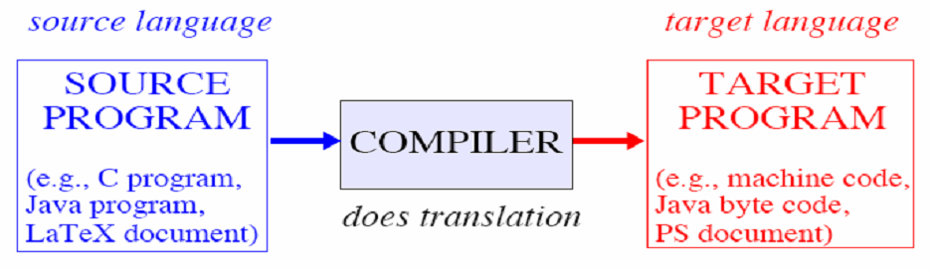
The Compiler
A program that translates the code written according to a language specs, to the code executable on the target platform

Slide 22
The Compiler
Does three main tasks:
  TRANSLATION
  VALIDATION
  OPTIMIZATION

Slide 23
The Compiler job 1 – TRANSLATION
Must ensure that Source program and target program are equivalent
Compile time: when the compiler program runs
Run time: when the target program runs
The programming language in which the compiler is implemented is the implementation language

Slide 24
The Compiler job 2 – VALIDATION
Rejects programs that have errors in them
What sort of error may be detected by a compiler?
  Static checks occur at compile time.
  Dynamic checks occur at run time.
A compiler cannot detect whether a program will produce the output that the programmer expects.

Slide 25
The Compiler job 3 – OPTIMIZATION
Tries to produce as good a target program as it can
Criterion for goodness could be
    How fast the target program runs(most common)
    OR
    Consumption of power and/or memory
Differences among compilers depends on
Their source and target languages,
as well as
on the relative importance of these three jobs

Slide 26
The Compiler
Does 3 Main tasks:
    TRANSLATION
    VALIDATION
    OPTIMIZATION
These 3 main Tasks can be further expanded to:
Twelve major Activities
or
Twelve Phases of Compilation Process

Slide 27
Phases of a Compilation
Phases describe major activities that happen in a compilation Process & the sequence in which it happens
The Twelve major activities are:
Lex
Parse
Semantic Actions
Semantic Analysis
Frame layout
Translate
Canonicalize
Instruction Selection
Control Flow Analysis
Data Flow Analysis
Register Allocation
Code Gen

Slide 28
Phases of Compilation
Lex
Parse
Semantic Actions
Semantic Analysis
Framing
Translate
Break the source into words or tokens
Analyze the phrase structure of the program
Build a piece of abstract syntax tree corresponding to each phrase
Check phrase meanings, use of variables with definition
Place variables, parameters in a frame
Produce Intermediate Representation trees - language & m/c independent

Slide 29
Canonicalize
Instruction Selection
Control flow analysis
Data flow Analysis
Register Allocation
Code Gen
Remove side effects and clean-up conditional branches
Group IR tree into lumps that correspond to the actions of the Target Machine
Analyze sequence of instructions into flow graph with all possible control flows
Live-ness analysis calculates the places where variable holds a still-needed value
Register to hold the variable & temporary values Concept register sharing.
Generate Final Machine Code

Slide 30
Structure of a Compiler
The phases ( Activities) of Compilation are carried out by:
Different Modules of a Compiler.
These Modules may need to scan the source code multiple times ( Known as Passes) to complete all the twelve phases of compilation
This, they do in two parts known as:
      1. ANALYSIS Part &
      2. SYNTHESIS Part
The structure & functioning of these modules in one or several pass(es) defines the Architecture of Compiler

Slide 31
Architecture of a COMPILER
LEXICAL ANALYSER
SYNTAX ANALYSER
SEMANTIC ANALYSER
INT. CODE GEN.
CODE OPTIMISER
CODE GENERATOR
SYMBOL
TABLE
MANAGER
ERROR
HANDLER

Slide 32
Architecture of a COMPILER
LEXICAL ANALYSER
SYNTAX ANALYSER
SEMANTIC ANALYSER
INT. CODE GEN.
CODE OPTIMISER
CODE GENERATOR
ANALYSIS
Part
(A.k.a Front end)
SYMBOL
TABLE
MANAGER
ERROR
HANDLER
SYNTHESIS
Part
(A.k.a Back end)

Slide 33
Flow of data in Compiler modules
Source program
Intermediate-code Generator
Lexical Analyzer (Scanner)
Non-optimized Intermediate Code
Tokens
Intermediate-code Optimizer
Syntax Analyzer (Parser)
Optimized Intermediate Code
Parse tree
Semantic Analyzer
Target-code Generator
Target machine code
Abstract Syntax Tree w/ Attributes

Slide 34
LEXICAL ANALYSER
Functionality
INPUT – Program text as a sequence of Characters
OUTPUT – Program Text as a sequence of symbols (Tokens)
position = initial + rate * 60
id1:= id2 + id3 * 60

Slide 35
LEXICAL ANALYSER
Tasks involved are
  Read the input file
  Compresses the text by Ignoring spaces (but not inside quotes)
  Identify “TOKENS” – the language key words & identifiers
    Notation to denote the composition of tokens (regular expressions).
    Internal representation of token definition(finite state machines ).
    Algorithms for identifying tokens.
  Count line numbers
  Report errors about symbols illegal in the language
Tools available for defining tokens, which automatically generate a program for identifying them (e.g., LEX)

Slide 36
SYNTAX
The syntax of a programming language describes the structure of programs without any consideration of their meaning.
The syntactic elements of a programming language are determined by the computation model and pragmatic concerns
Well developed tools (regular expression, context-free and attribute grammars) for the description of the syntax of programming language

Slide 37
SYNTAX ANALYSER
Checks the syntactical correctness of the program and generates errors if any discrepancy is found
Uses Notation to denote the syntax of a program (Bachus Naur Form, Context-free grammar)
Internal representation (Pushdown automata, Parse trees).
Several Algorithms for syntax analysis
Tools for generating the syntax analyzer (YACC)

Slide 38
SYNTAX ANALYSER
Functionality
INPUT – Sequence of symbols (tokens)
OUTPUT – Structure of the program ( an abstract syntax tree)
id1:= id2 + id3 * 60
=
id1
+
id2
*
id3
60

Slide 39
SEMANTIC ANALYSER
Check consistency in types between the different components of the expression.
Check correspondence between parameters in procedure calls.
INPUT – Abstract Syntax tree
OUTPUT – Abstract tree decorated with attributes like Type of sub-expressions & Symbol table
=
id1
+
Symbol Table
id2
*
Position
Initial
Rate
inttoreal
id3
60

Slide 40
INTERMEDIATE CODE GENERATOR
Generates intermediate code as a first step in translation
=
INPUT – Abstract Syntax tree
OUTPUT – Intermediate Code
id1
+
id2
*
temp1 := inttoreal (60);
temp2 := id3* temp1
temp3 := id2 + temp2;
id1 = temp3;
inttoreal
id3
60

Slide 41
CODE OPTIMISER
Optimizes the code in terms of number of instructions ( and hence the execution time).
temp1 := inttoreal (60);
temp2 := id3*temp1
temp3 := id2 + temp2;
id1 = temp3;
INPUT – Intermediate code
OUTPUT – Optimized intermediate Code
temp1 := id3 * 60.0;
id1 := id2 + temp1;

Slide 42
CODE GENERATOR
Converts the logical code to machine specific Assembly instructions
temp1 := id3 * 60;
id1 := id2 + temp1;
INPUT – Optimized intermediate Code
OUTPUT – Corresponding Assembly Code
MOVF id3,R2
MULF #60.0,R2
MOVF id2, R1
ADDF R2.R1
MOVF R1, id1

Slide 43
Symbol Table & Error Handling
Symbol Table
  Needs to update in various stages.
  Define variables
  Check type consistency
  Enforce scope rules
  Generate run-time environment
Error handling
  Important in all stages
  How to generate informative error messages (syntax error at line 17…).
  How to prevent error propagation (variable not declared, expression not well defined, procedure call not well defined, etc.).
  How to best guess user’s intention?

Slide 44
Accessories of Compiler
Editor
  An editor is a tool used to create and modify source files, which are files of characters that comprise a program in a language.
Preprocessors
  Perform functions like Macro Processing, File Inclusion and Language Extensions etc..
Assemblers
  Some compilers produce Assembly language code
  Instead of relocatable code normally produced
  Useful in development of cross compilers
………. Contd.

Slide 45
Accessories of Compiler (Contd.)
Linker
  Collects the object files of the components of the program and resolves external references from one component to another in order to form an executable file.
Loader
  Copies the executable file from the disk into memory, and initializes the computer before executing the program.
Debugger
  A tool to control the execution of a program at the level of individual statements, so that bugs can be diagnosed.
………. Contd.

Slide 46
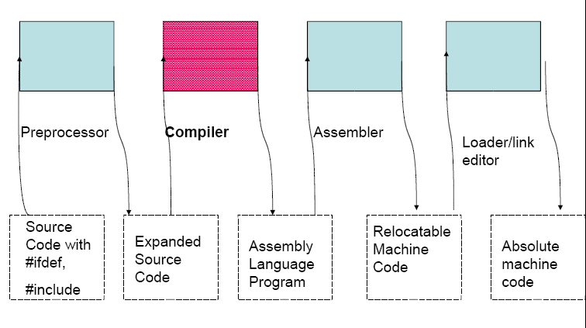
Compiler & its Accessories in Context

Slide 47
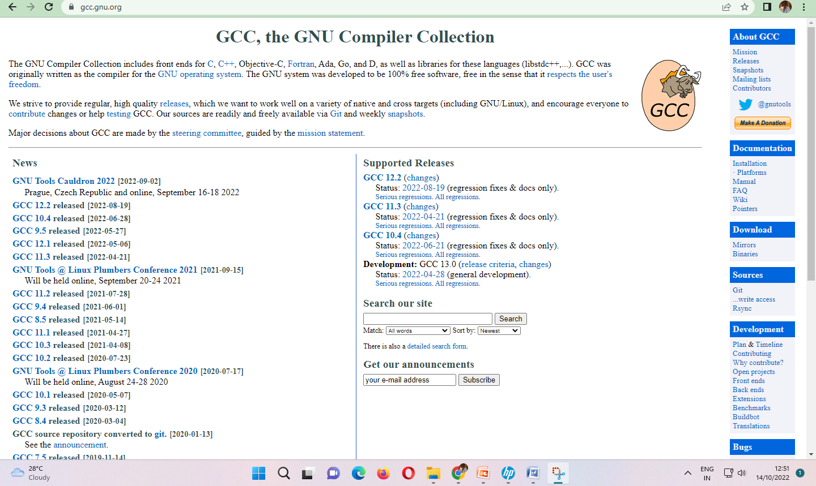
GCC, the GNU Compiler Collection

Slide 48
What is GCC?
GCC is the GNU Project C compiler
A command-line program
GCC takes C source files as input
Outputs an executable: a.out
You can specify a different output filename
Available for you to use on spinlock/coredump

Slide 49
Gcc example:
“hello.c” is the name of the file with the following contents:
#include <stdio.h>
int main(void) {
printf(“Hello\n“);
}
To compile simply type: gcc –o hello hello.c –g -Wall
  ‘-o’ option tells the compiler to name the executable ‘hello’
  ‘-g’ option adds symbolic information to Hello for debugging
  ‘–Wall’ tells it to print out all warnings (very useful!!!)
To execute the program simply type: ./hello
  It should output “Hello” on the console

Slide 50
What is Gdb?
GDB is the GNU Project debugger
Gdb provides some helpful functionality
  Allows you to stop your program at any given point.
  You can examine the state of your program when it’s stopped.
  Change things in your program, so you can experiment with correcting the effects of a bug.
Also a command-line program
Is also available on spinlock/coredump

Slide 51
Using Gdb:
To start gdb with your hello program type: gdb Hello
When gdb starts, your program is not actually running.
You have to use the run command to start execution.
Before you do that, you should place some break points.
Once you hit a break point, you can examine any variable.

Slide 52
Useful gdb commands
run command-line-arguments
  Begin execution of your program with arguments
break place
  place can be the name of a function or a line number
  For example: break main will stop execution at the first instruction of your program
delete N
  Removes breakpoints, where N is the number of the breakpoint
step
  Executes current instruction and stops on the next one

Slide 53
Gdb commands cont.
next
  Same as step except this doesn’t step into functions
print E
  Prints the value of any variable in your program when you are at a breakpoint, where E is the name of the variable you want to print
help command
  Gives you more information about any command or all if you leave out command
quit
  Exit gdb

Slide 54
Questions...

Slide 55
Thank you

